Slide 1
Trailing Edge Separation

Slide 2
Trailing Edge Separation
17 Submitted Data Sets (as of June 24)
Grids
11 Unstructured
3 Overset
2 Multi-block
1 Hybrid Unstr/Cart
Turbulence Models
3 SA (RC)
10 SA QCR (RC)
1 AMM QCR
1 SST
2 EARSM

Slide 3
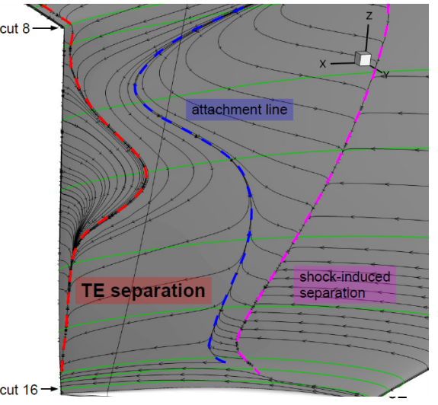
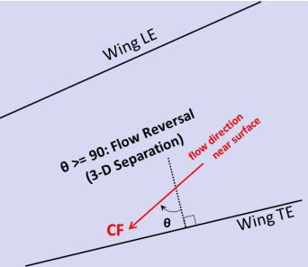
Trailing Edge Separation
Criteria: C_{f} normal to TE < 0
difficult to detect at higher α

Slide 4
Case 1a
CRM Wing-Body Grid Convergence Study
M = 0.85 |C_{L} = 0.58 |Rey# = 20M

Slide 5
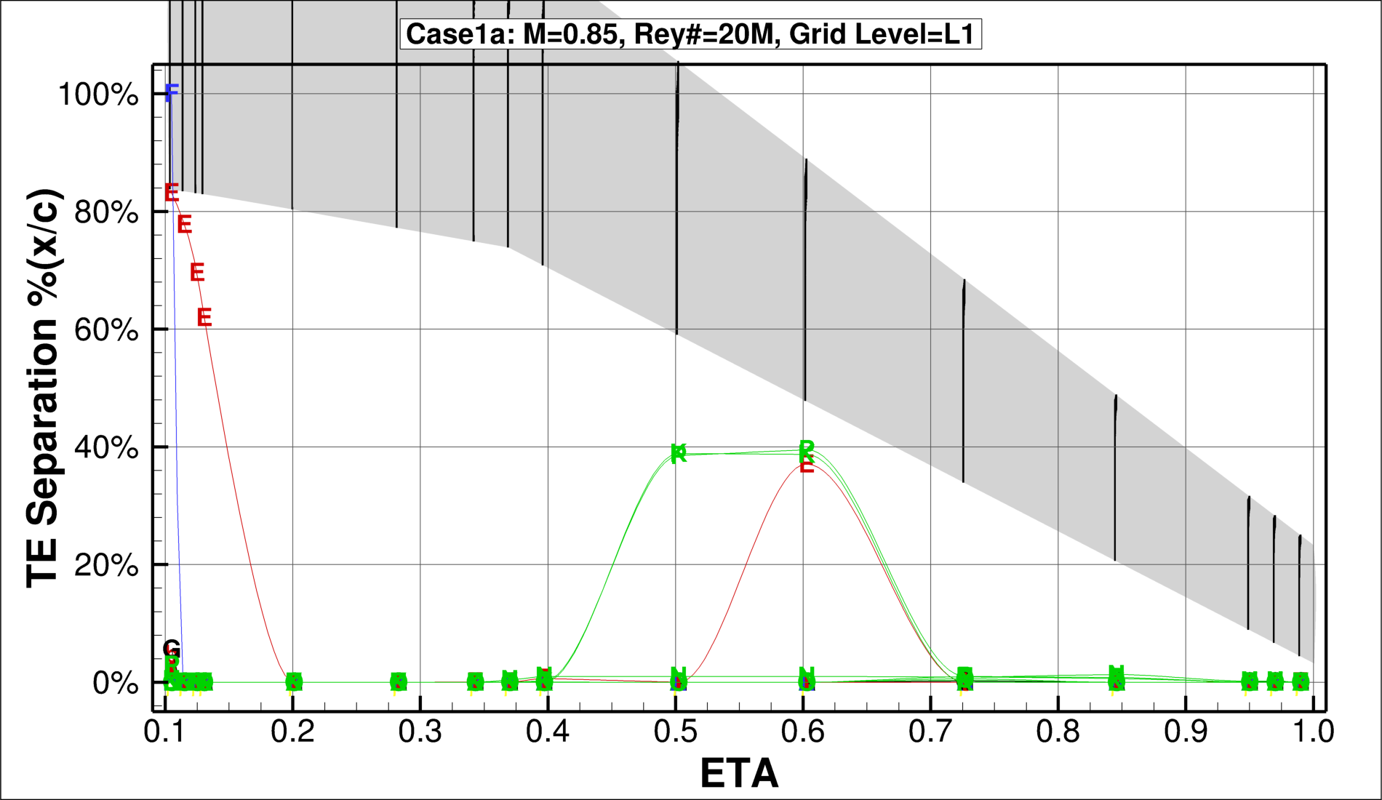
Turbulence Model
SA
SA QCR (RC)
SST
EARSM AMM QCR

Slide 6
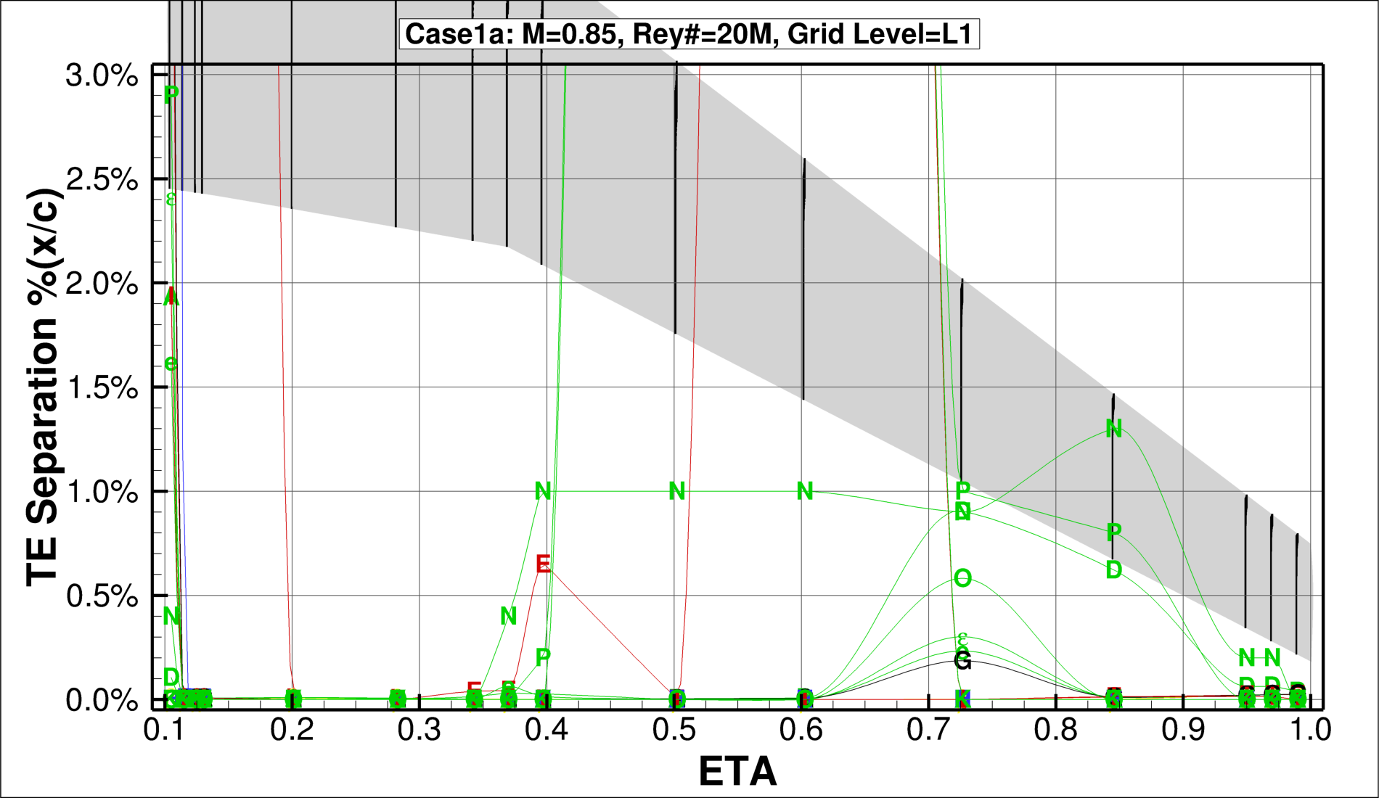
Turbulence Model
SA
SA QCR (RC)
SST
EARSM AMM QCR

Slide 7
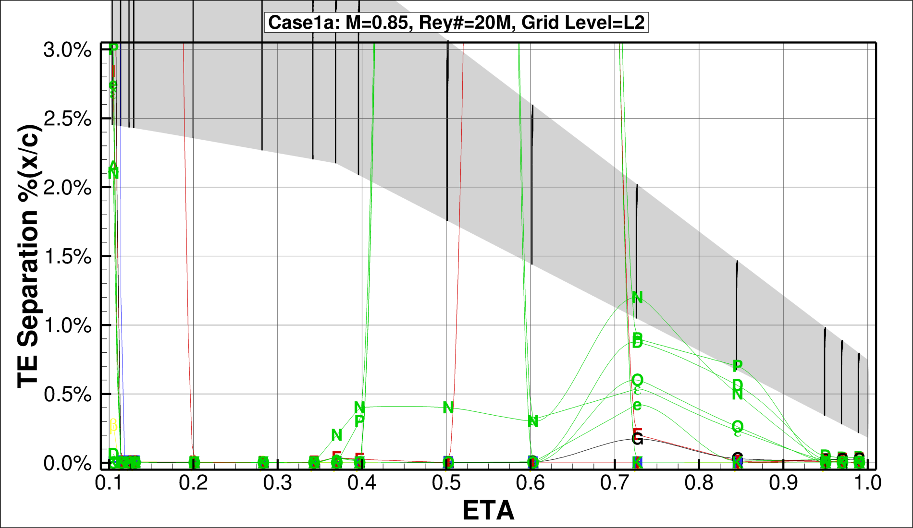
Turbulence Model
SA
SA QCR (RC)
SST
EARSM AMM QCR

Slide 8

Turbulence Model
SA
SA QCR (RC)
SST
EARSM AMM QCR

Slide 9

Turbulence Model
SA
SA QCR (RC)
SST
EARSM AMM QCR

Slide 10

Turbulence Model
SA
SA QCR (RC)
SST
EARSM AMM QCR

Slide 11
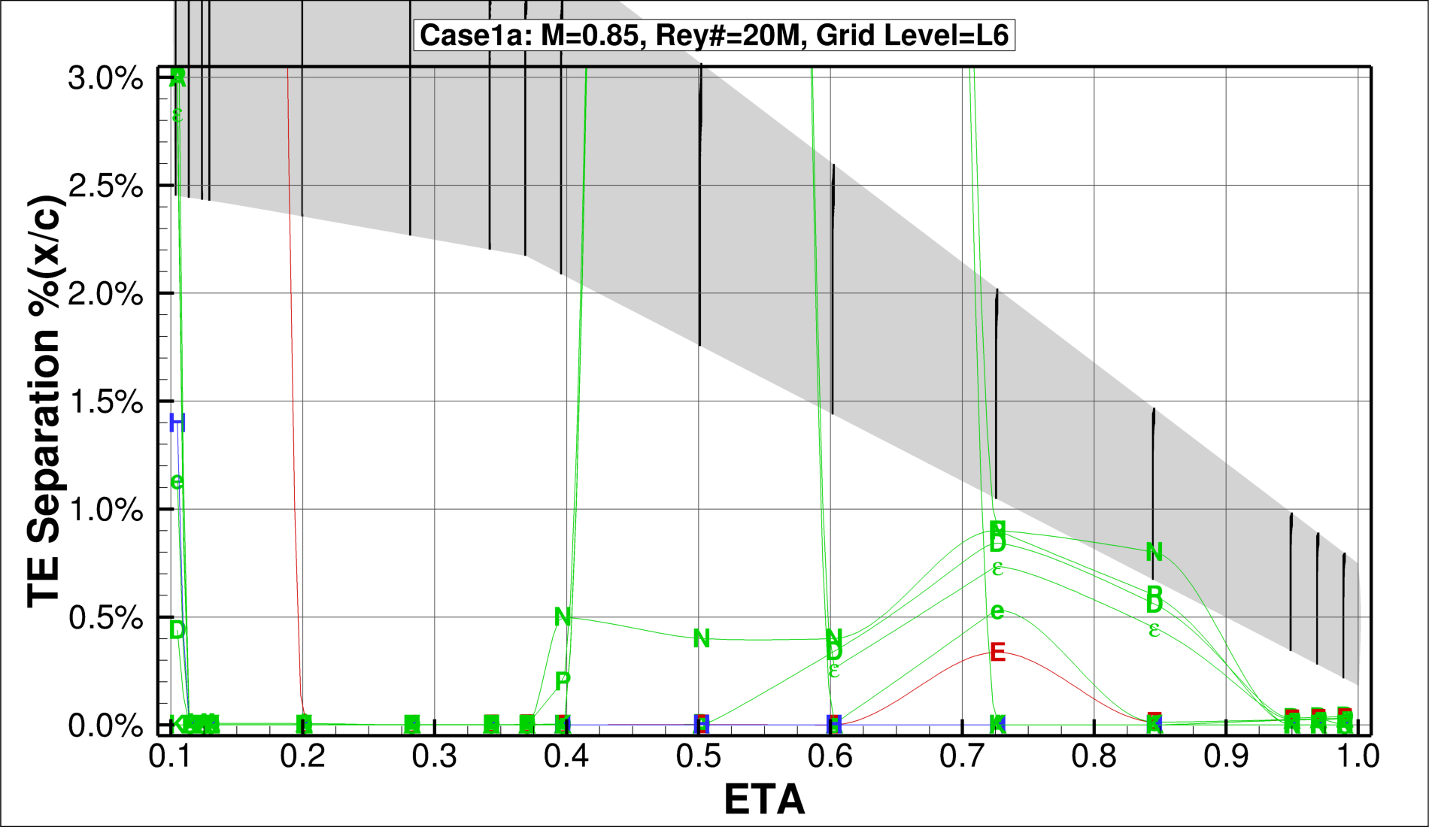
Turbulence Model
SA
SA QCR (RC)
SST
EARSM AMM QCR

Slide 12
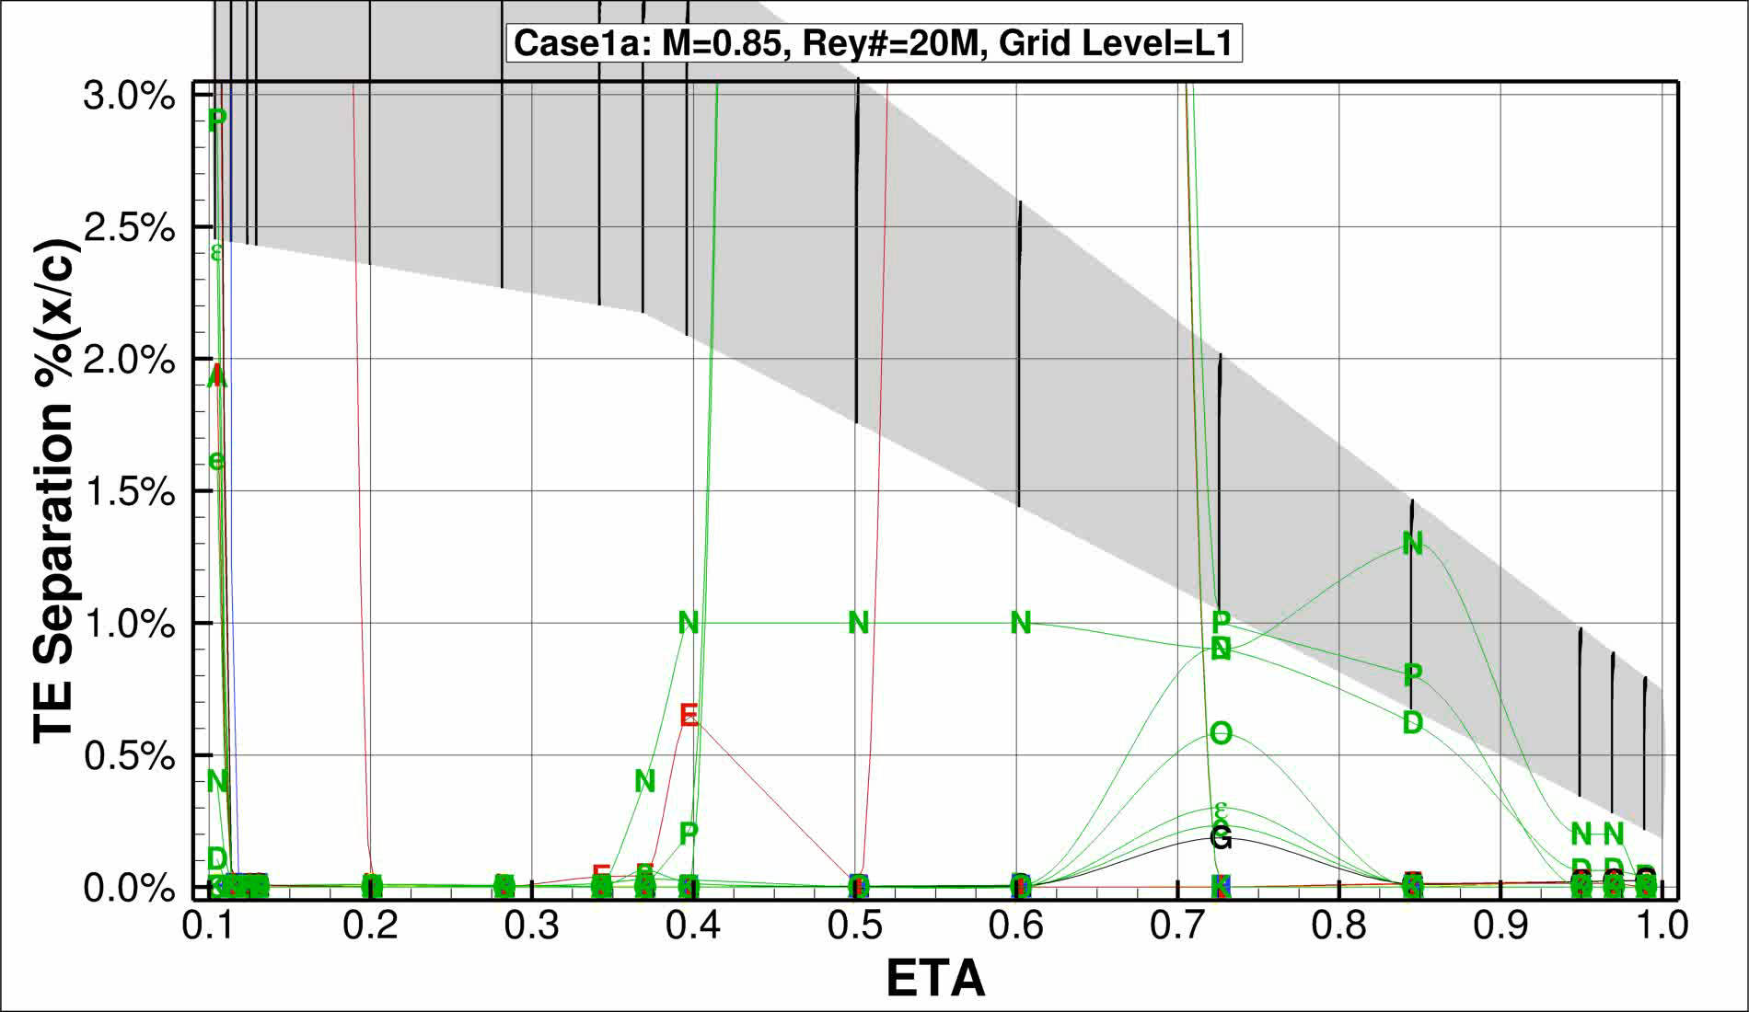
Animated Sweep
Turbulence Model
SA
SA QCR (RC)
SST
EARSM AMM QCR

Slide 13
Case 1b
CRM Wing-Body Grid Convergence Study
M = 0.85 |C_{L} = 0.58 |Rey# = 5M

Slide 14
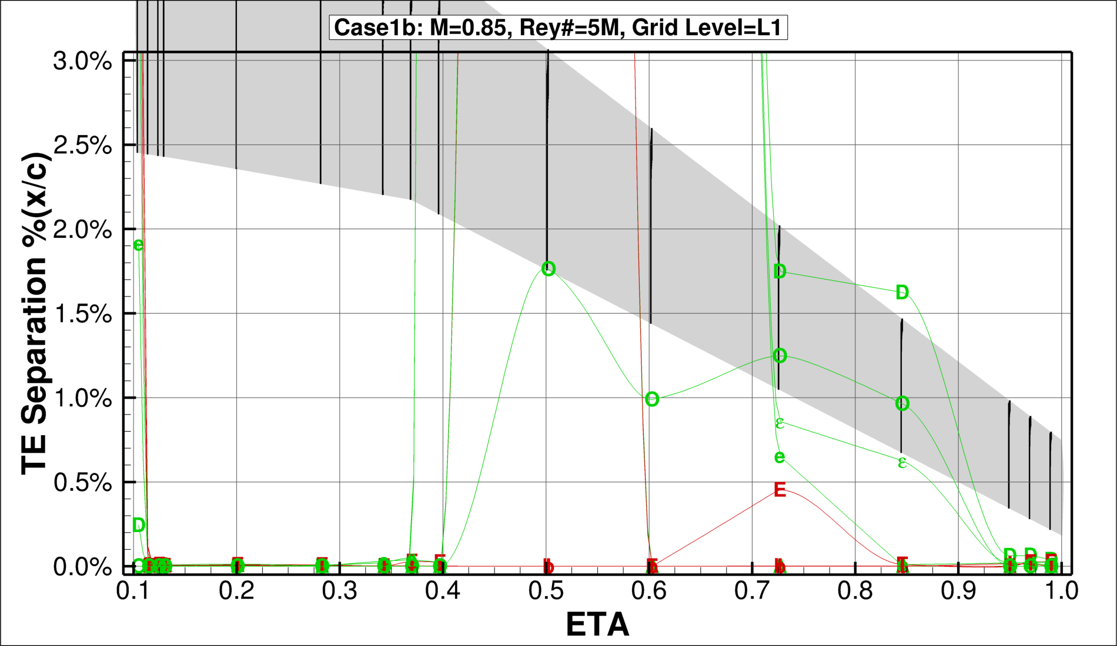
Turbulence Model
SA
SA QCR (RC)
SST
EARSM AMM QCR

Slide 15
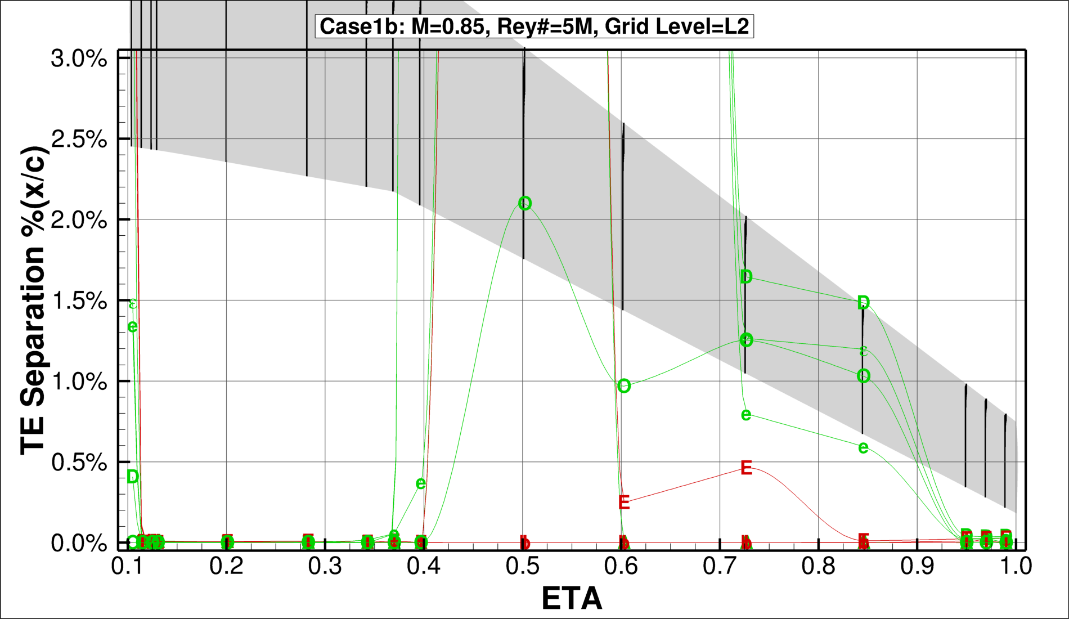
Turbulence Model
SA
SA QCR (RC)
SST
EARSM AMM QCR

Slide 16
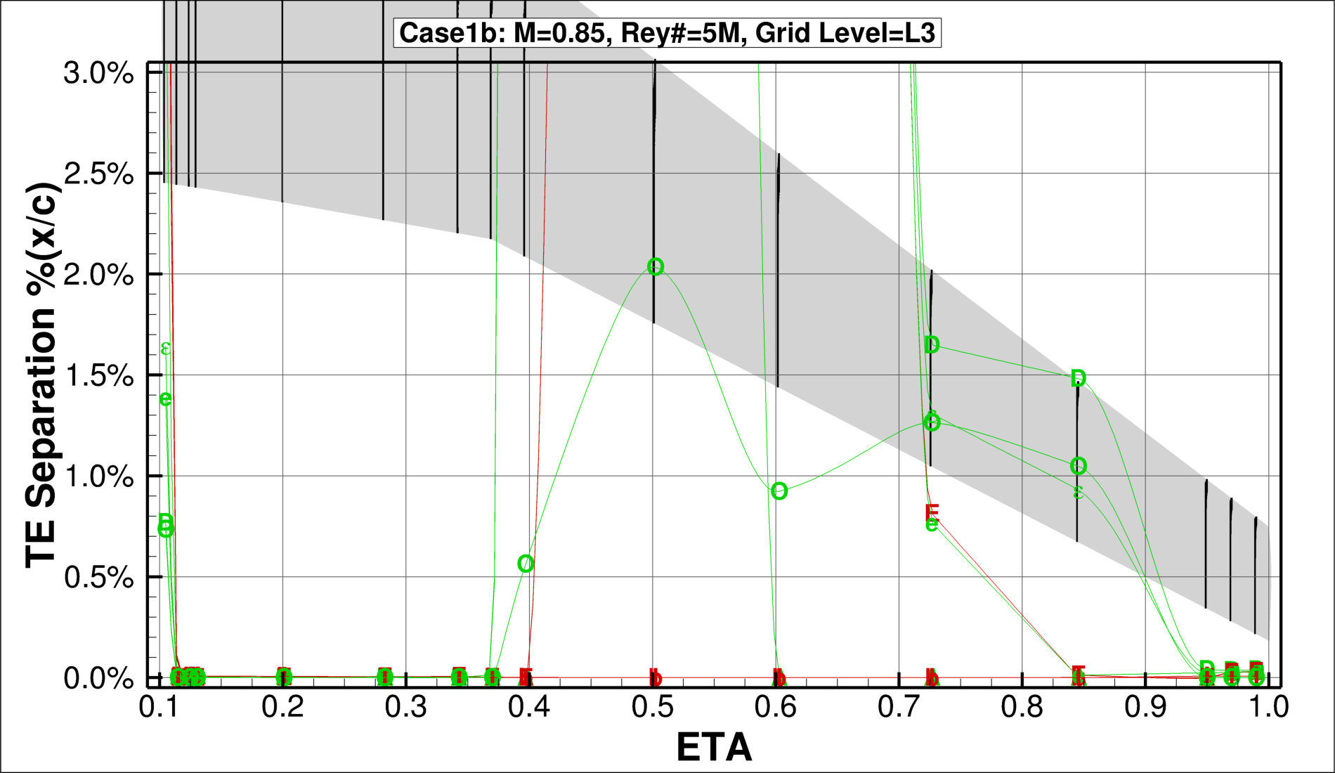
Turbulence Model
SA
SA QCR (RC)
SST
EARSM AMM QCR

Slide 17
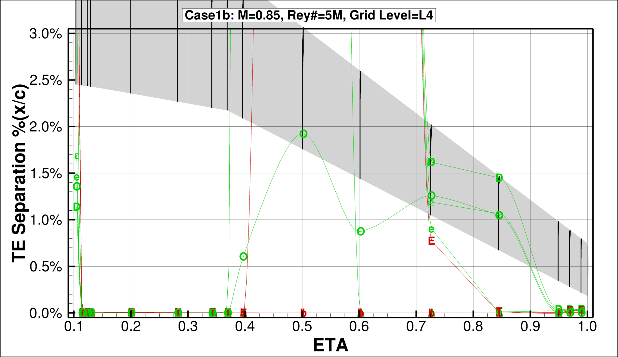
Turbulence Model
SA
SA QCR (RC)
SST
EARSM AMM QCR

Slide 18
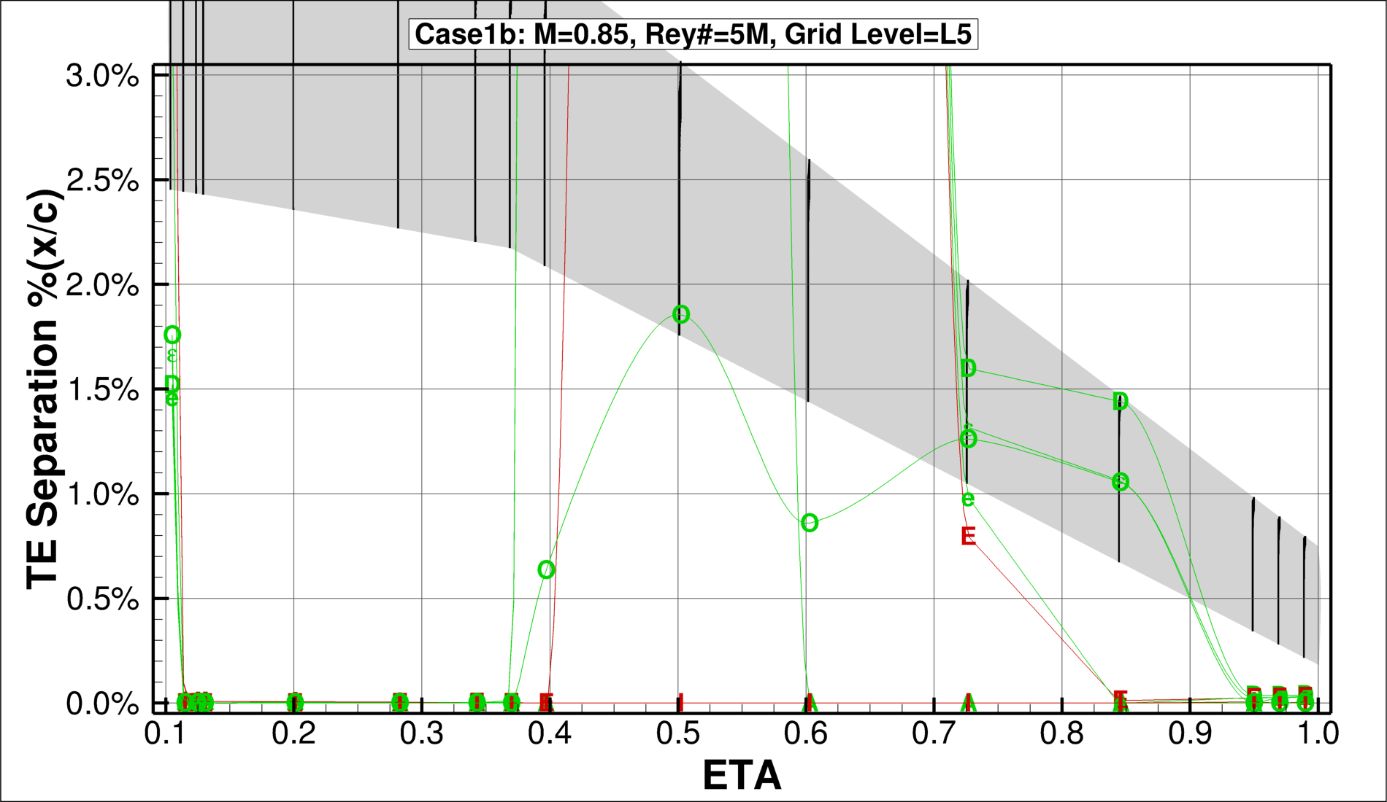
Turbulence Model
SA
SA QCR (RC)
SST
EARSM AMM QCR

Slide 19
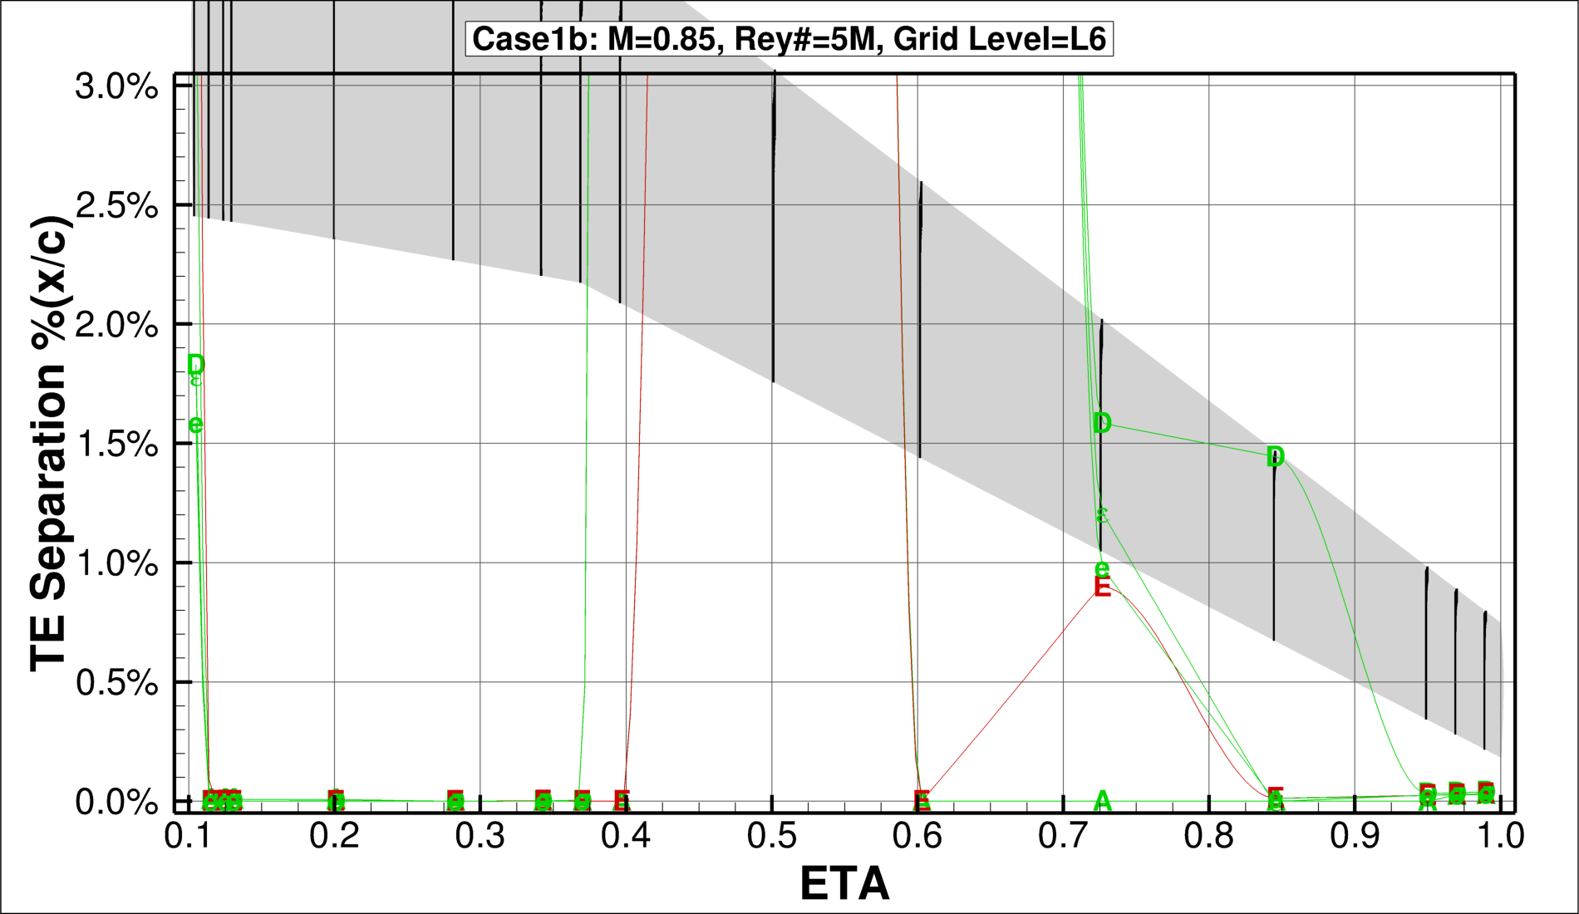
Turbulence Model
SA
SA QCR (RC)
SST
EARSM AMM QCR

Slide 20
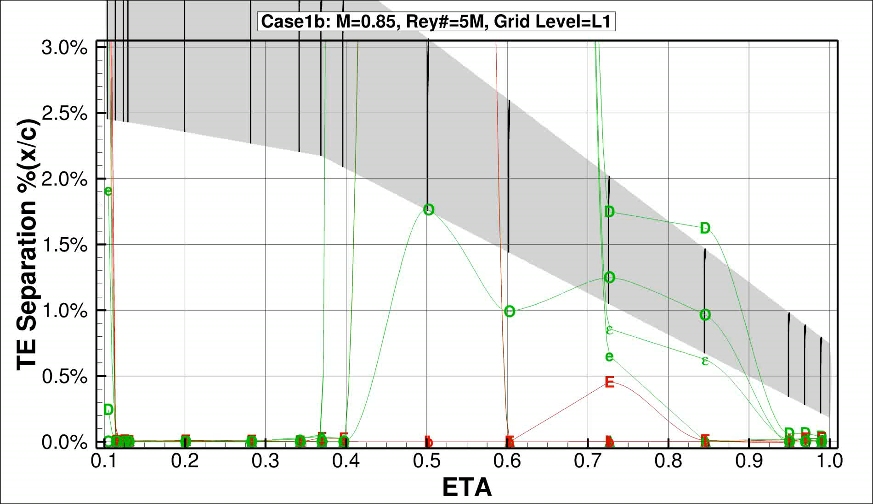
Animated Sweep
Turbulence Model
SA
SA QCR (RC)
SST
EARSM AMM QCR

Slide 21
Case 2a
CRM Wing-Body Alpha Sweep
M = 0.85 |α = 2.75–4.25º |Rey# = 20M

Slide 22
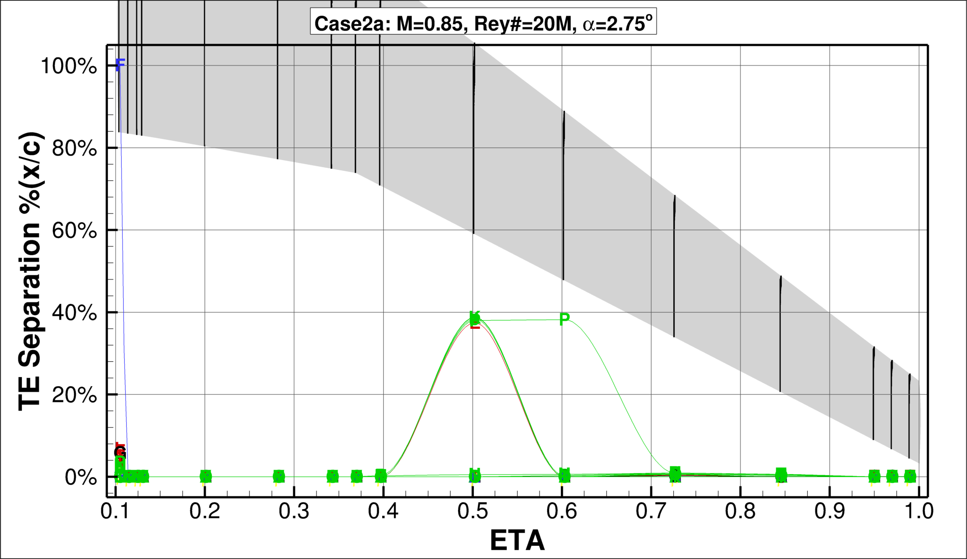
Turbulence Model
SA
SA QCR (RC)
SST
EARSM AMM QCR

Slide 23
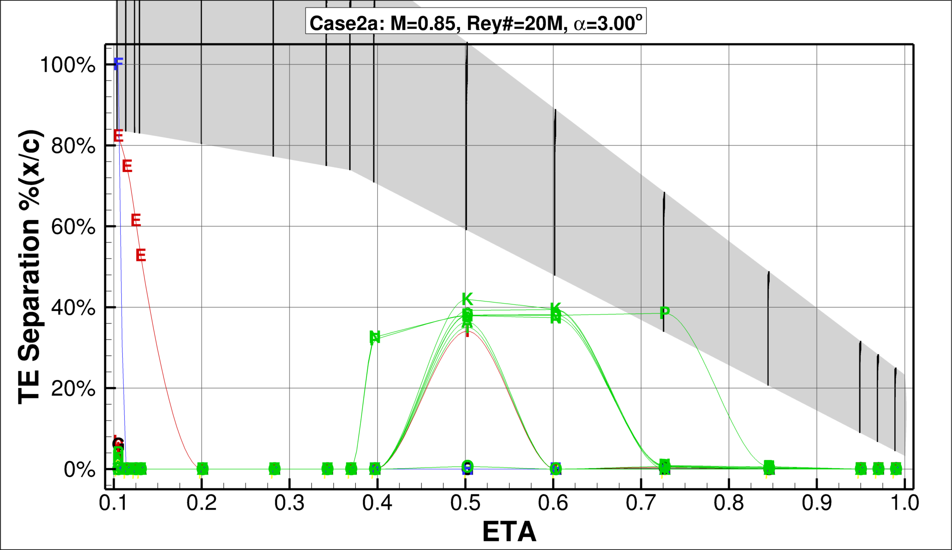
Turbulence Model
SA
SA QCR (RC)
SST
EARSM AMM QCR

Slide 24
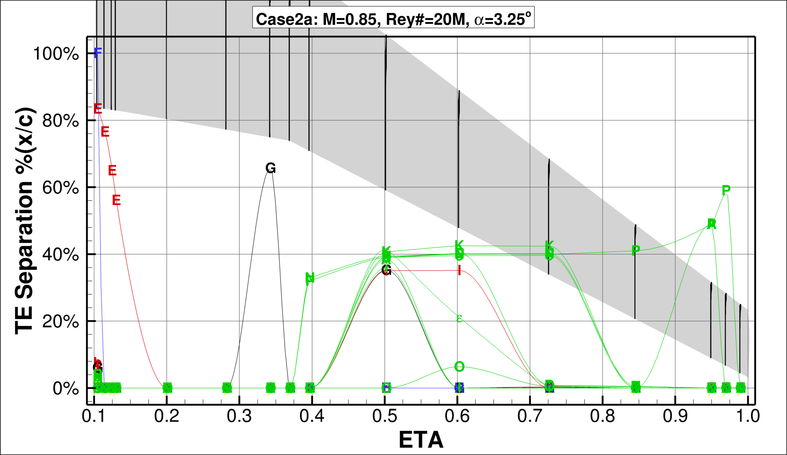
Turbulence Model
SA
SA QCR (RC)
SST
EARSM AMM QCR

Slide 25
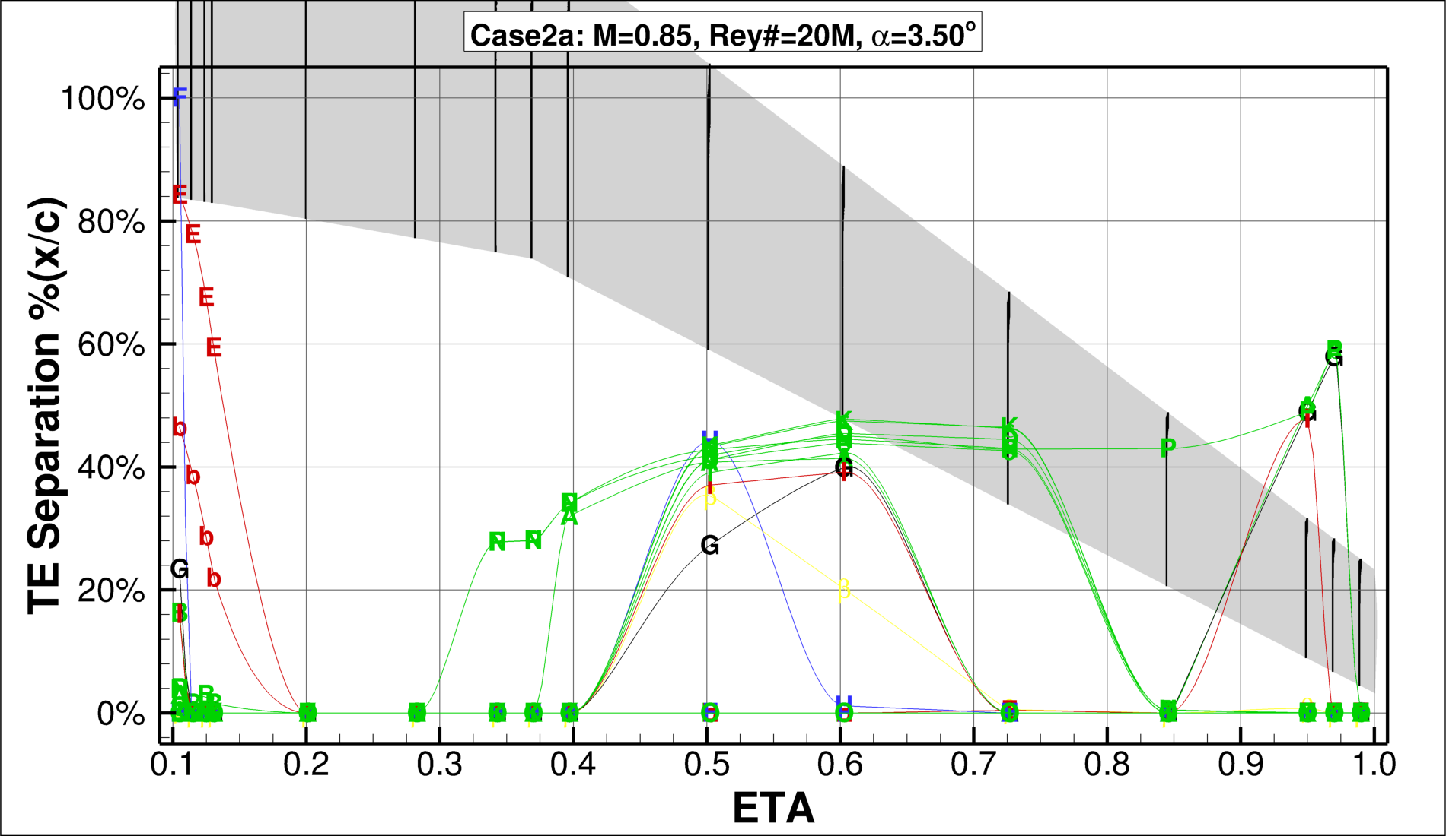
Turbulence Model
SA
SA QCR (RC)
SST
EARSM AMM QCR

Slide 26
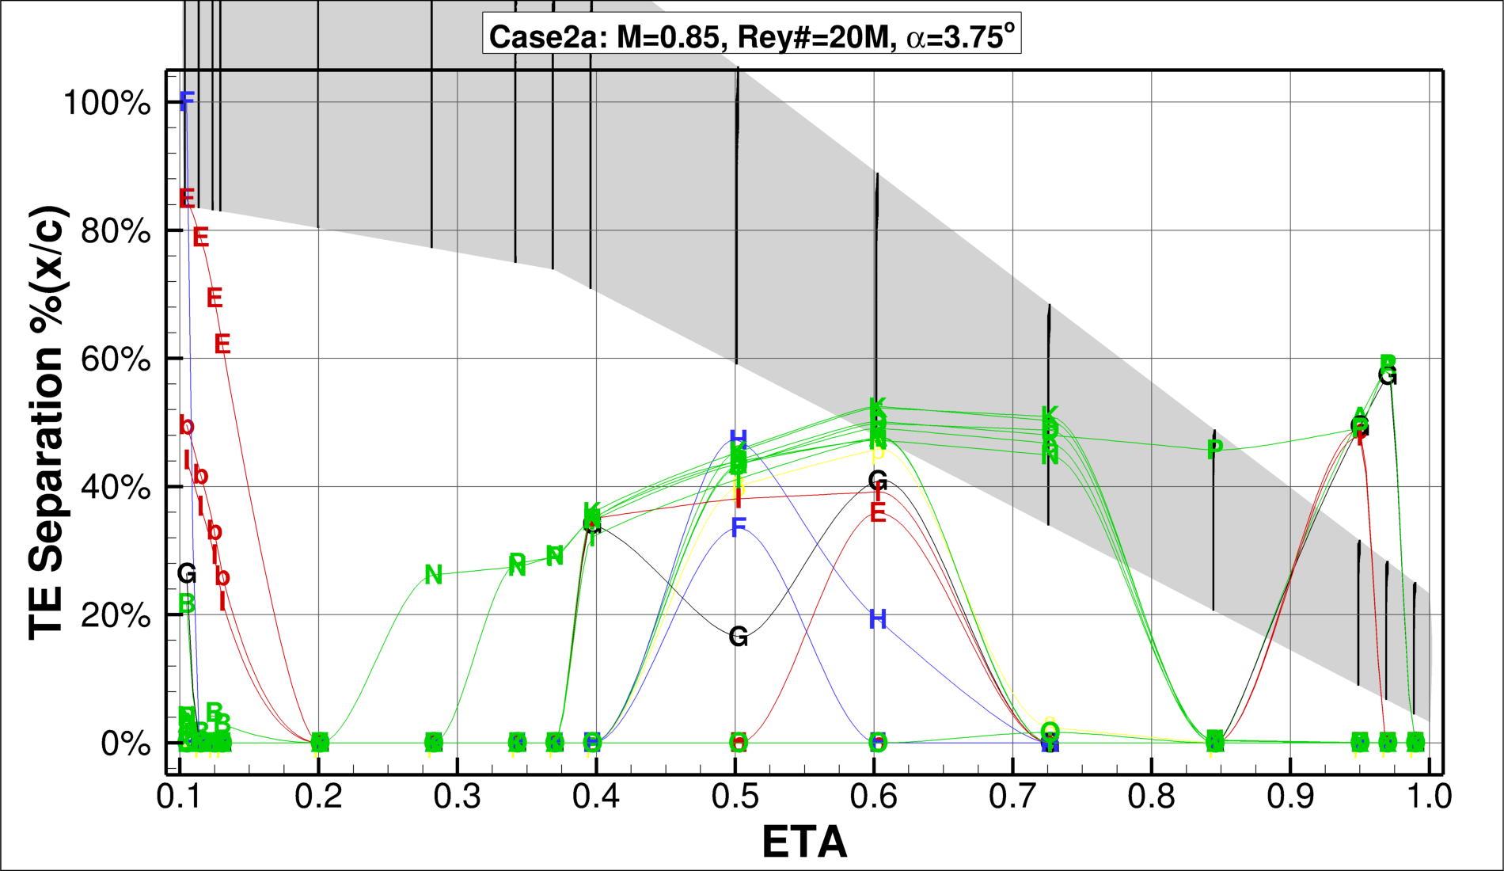
Turbulence Model
SA
SA QCR (RC)
SST
EARSM AMM QCR

Slide 27
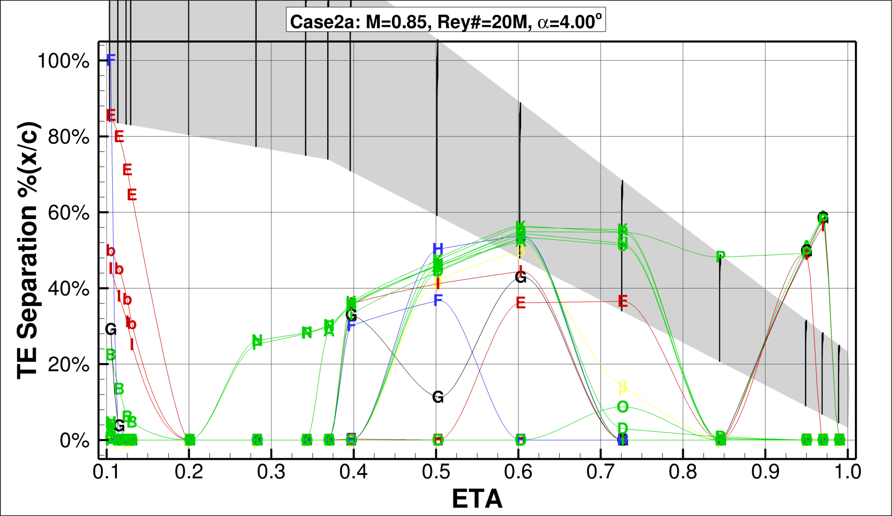
Turbulence Model
SA
SA QCR (RC)
SST
EARSM AMM QCR

Slide 28
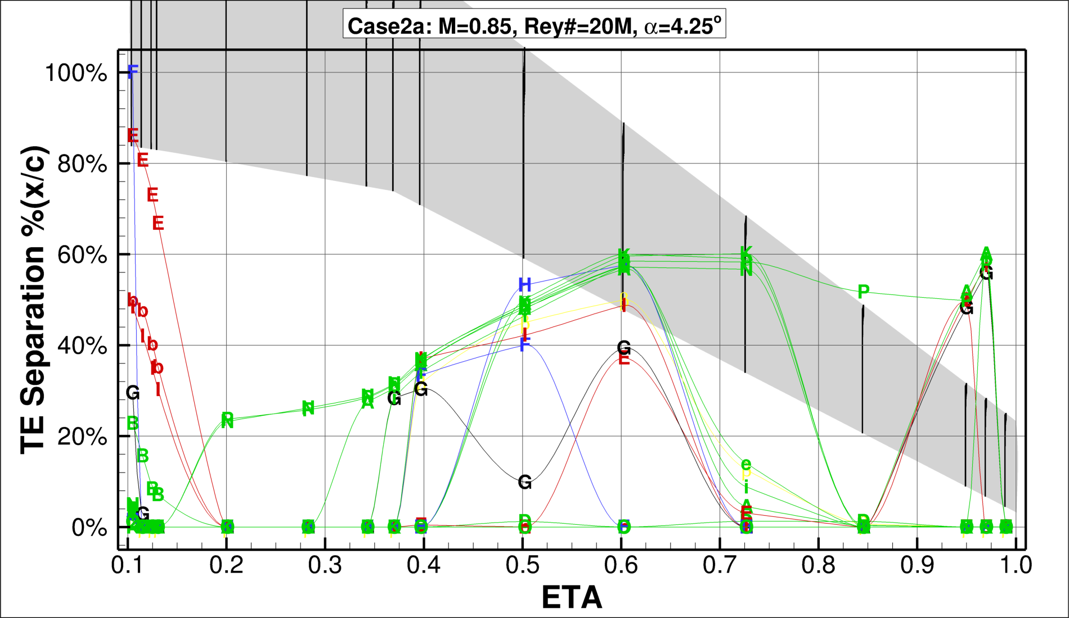
Turbulence Model
SA
SA QCR (RC)
SST
EARSM AMM QCR

Slide 29

Animated Sweep
Turbulence Model
SA
SA QCR (RC)
SST
EARSM AMM QCR

Slide 30
Case 2b
CRM Wing-Body Alpha Sweep
M = 0.85 |α = 2.75–4.25º |Rey# = 5M

Slide 31
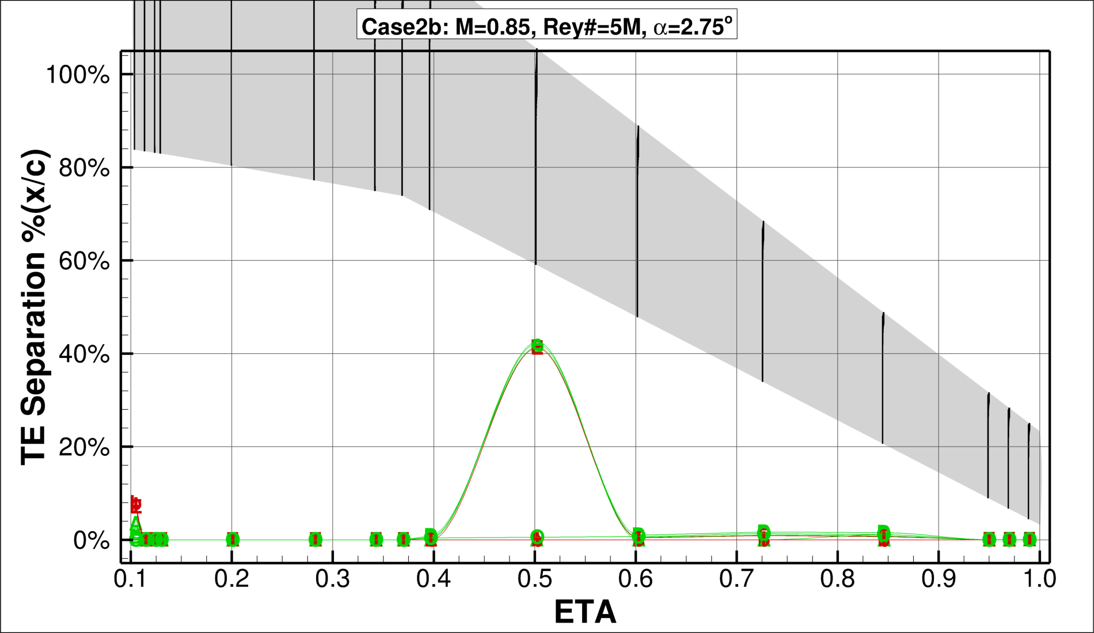
Turbulence Model
SA
SA QCR (RC)
SST
EARSM AMM QCR

Slide 32
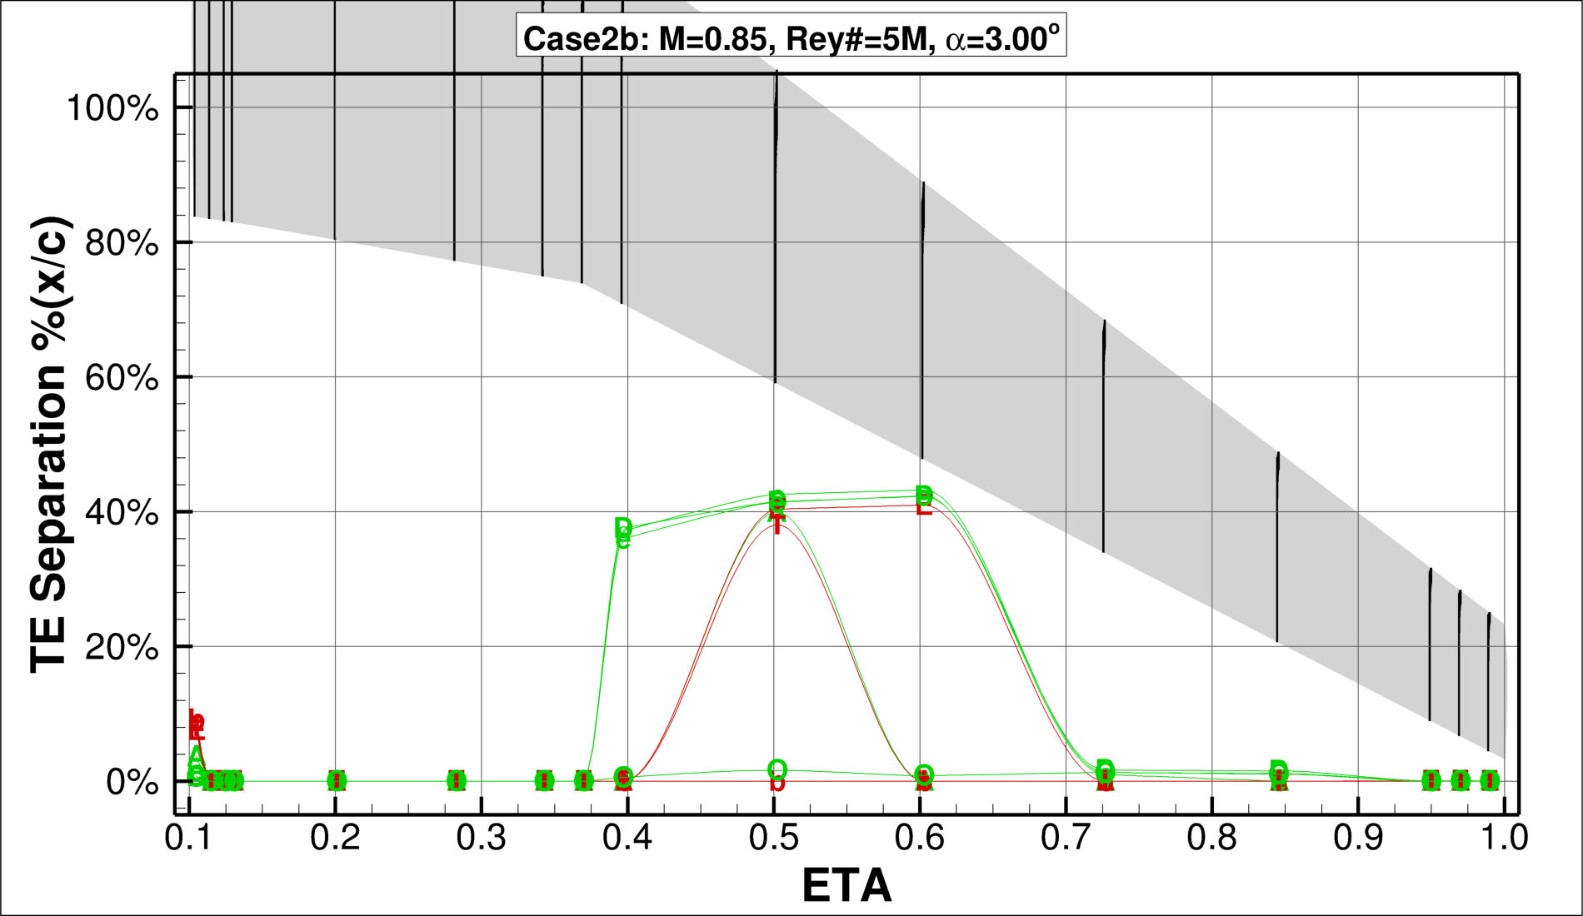
Turbulence Model
SA
SA QCR (RC)
SST
EARSM AMM QCR

Slide 33
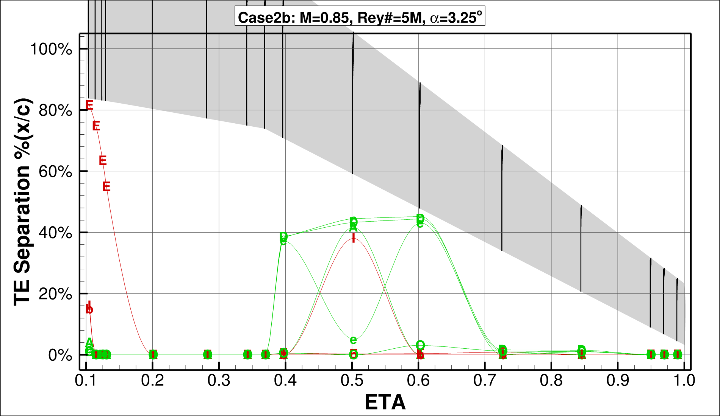
Turbulence Model
SA
SA QCR (RC)
SST
EARSM AMM QCR

Slide 34
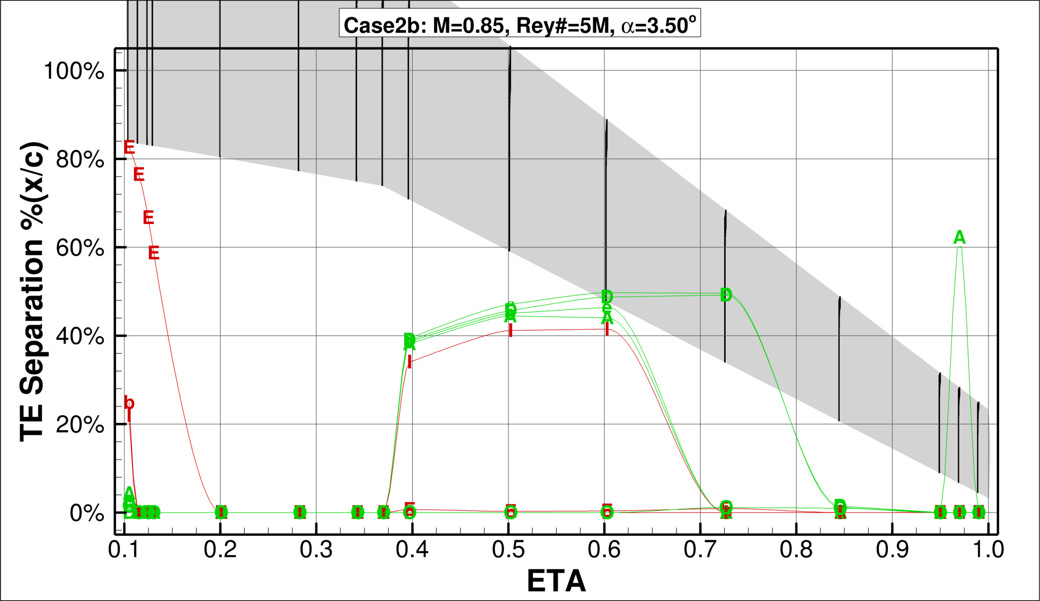
Turbulence Model
SA
SA QCR (RC)
SST
EARSM AMM QCR

Slide 35
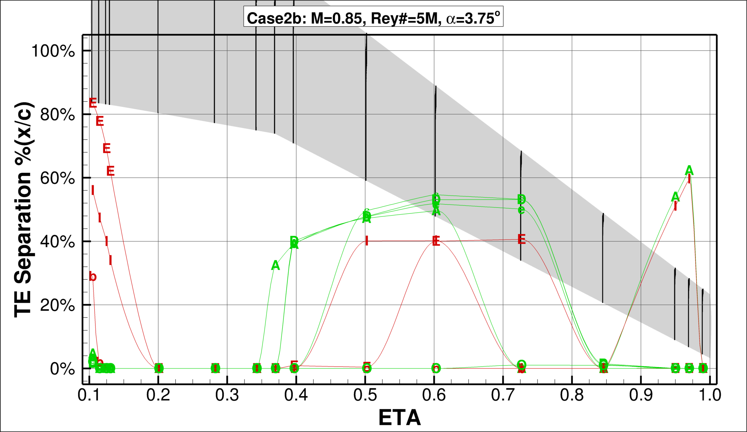
Turbulence Model
SA
SA QCR (RC)
SST
EARSM AMM QCR

Slide 36
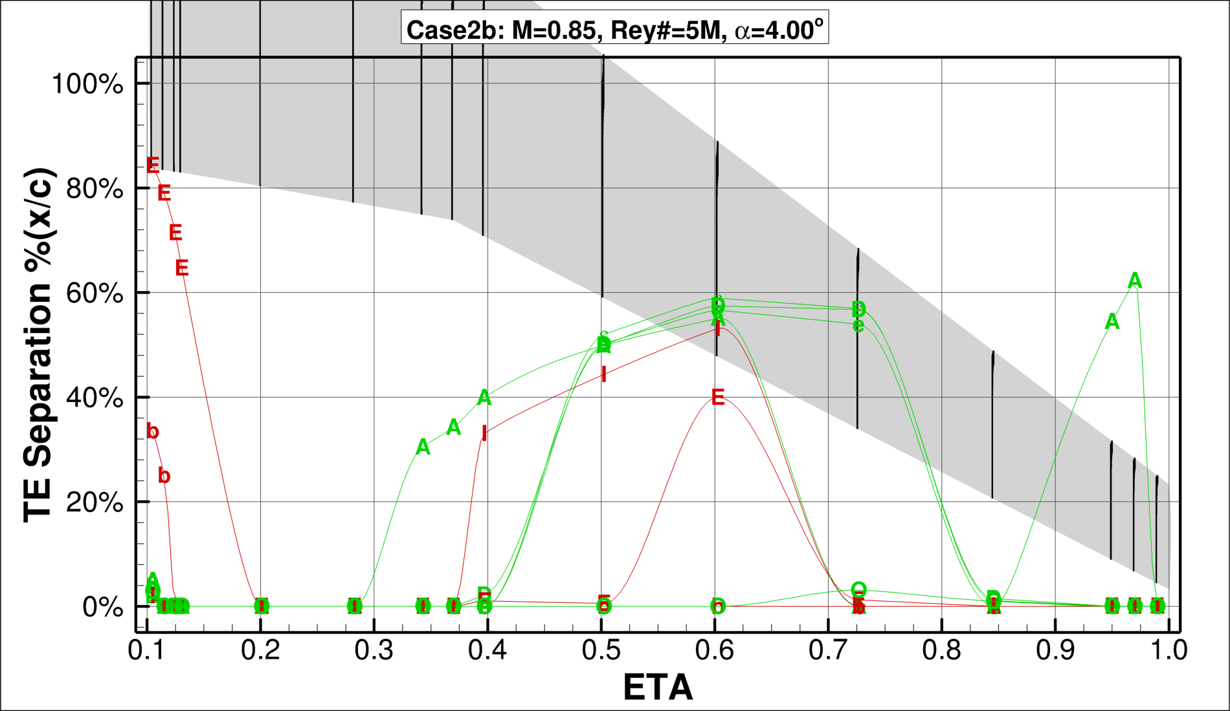
Turbulence Model
SA
SA QCR (RC)
SST
EARSM AMM QCR

Slide 37
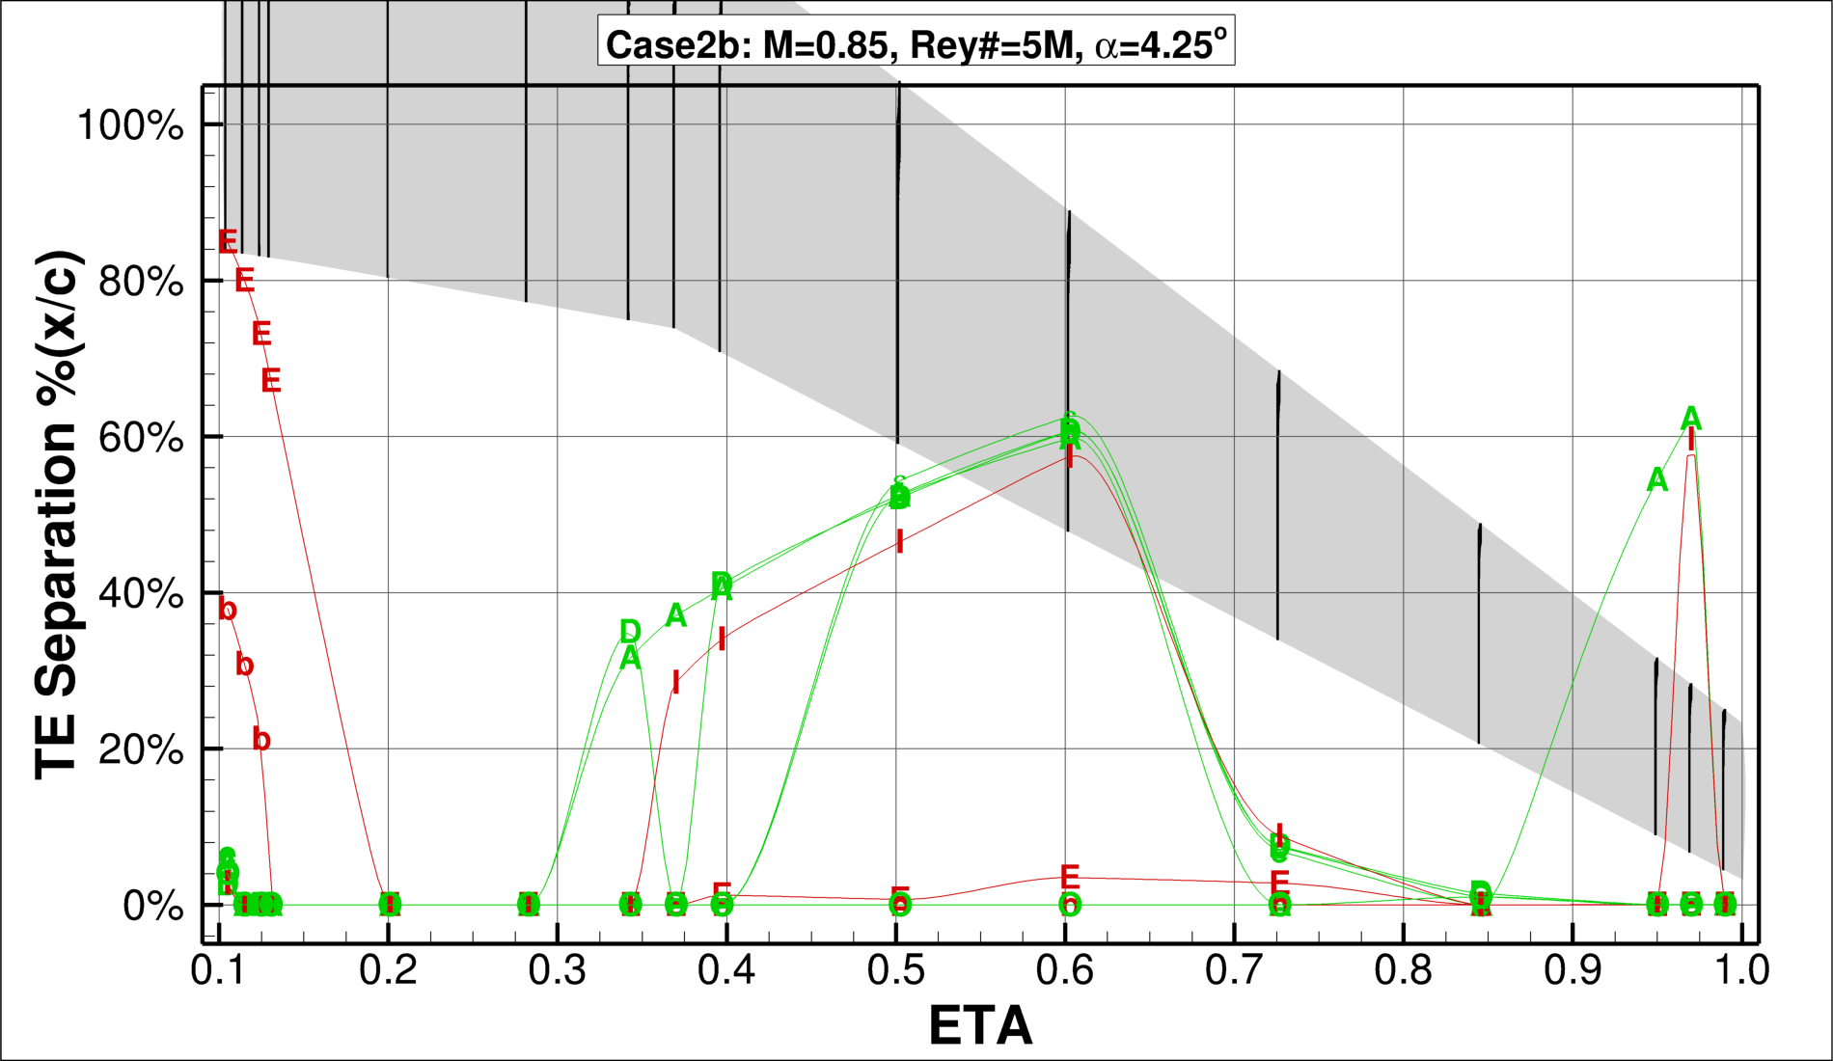
Turbulence Model
SA
SA QCR (RC)
SST
EARSM AMM QCR

Slide 38
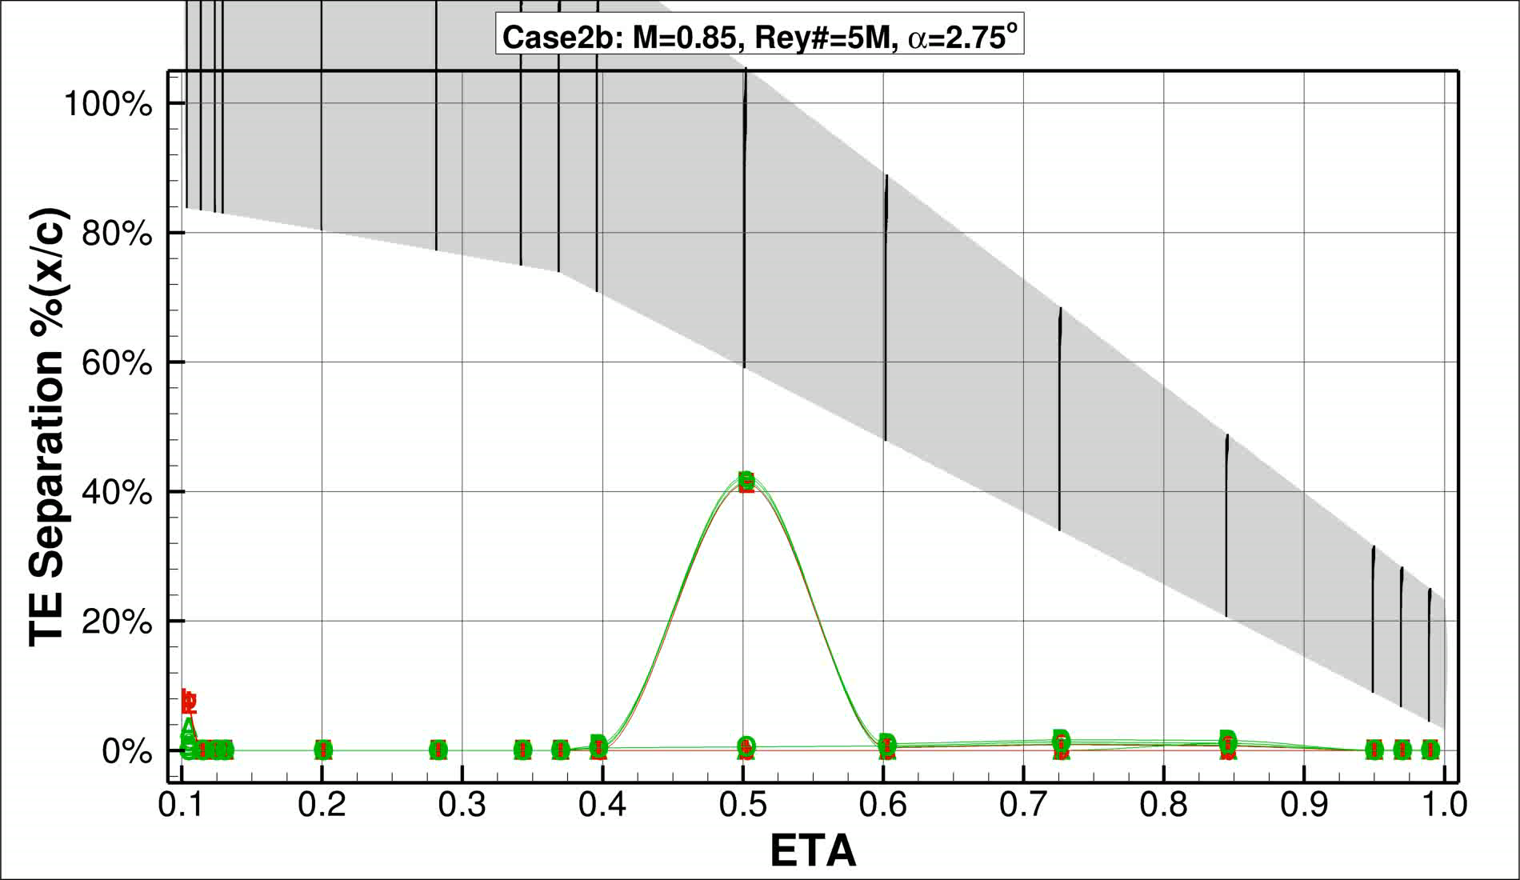
Animated Sweep
Turbulence Model
SA
SA QCR (RC)
SST
EARSM AMM QCR

Slide 39
Conclusions:
Extracting “TE” Separation is difficult to identify generally
Requires judgement about how to handle sections with a separation bubble at the shock extends far enough to be called TE separation and
Not enough data set for turbulence models other than SA-QCR to make judgments
Case 1
Reduced spread (within matching turbulence model) as grid density is increased
Case 2
Fairly good agreement between Yehudi break and eta=0.70.
Much more disagreement on inboard wing and wing tip

